Slide 1
Healthcare Analytics
Dialysis of Patients

Slide 2

Group Members
Anjali Patnaik
Madhurima Chatterjee
Ramnath Soudagar Gaikwad

Slide 3

Introduction
Dialysis is a procedure that is a substitute for many of the normal duties of the kidneys.
Dialysis healthcare analytics involves the analysis of key performance indicators(KPIs) to gain insight and make data-driven decisions in the field of dialysis care in order to enhance patient care, improve outcomes, optimize resource utilization, and drive continuous improvement in the field of dialysis treatment.

Slide 4

KPI’s
Number of Patients across various summaries
Profit Vs Non-Profit Stats
Chain Organizations w.r.t. Total Performance Score as No Score
Dialysis Stations Stats
# of Category Text - As Expected
Average Payment Reduction Rate

Slide 5
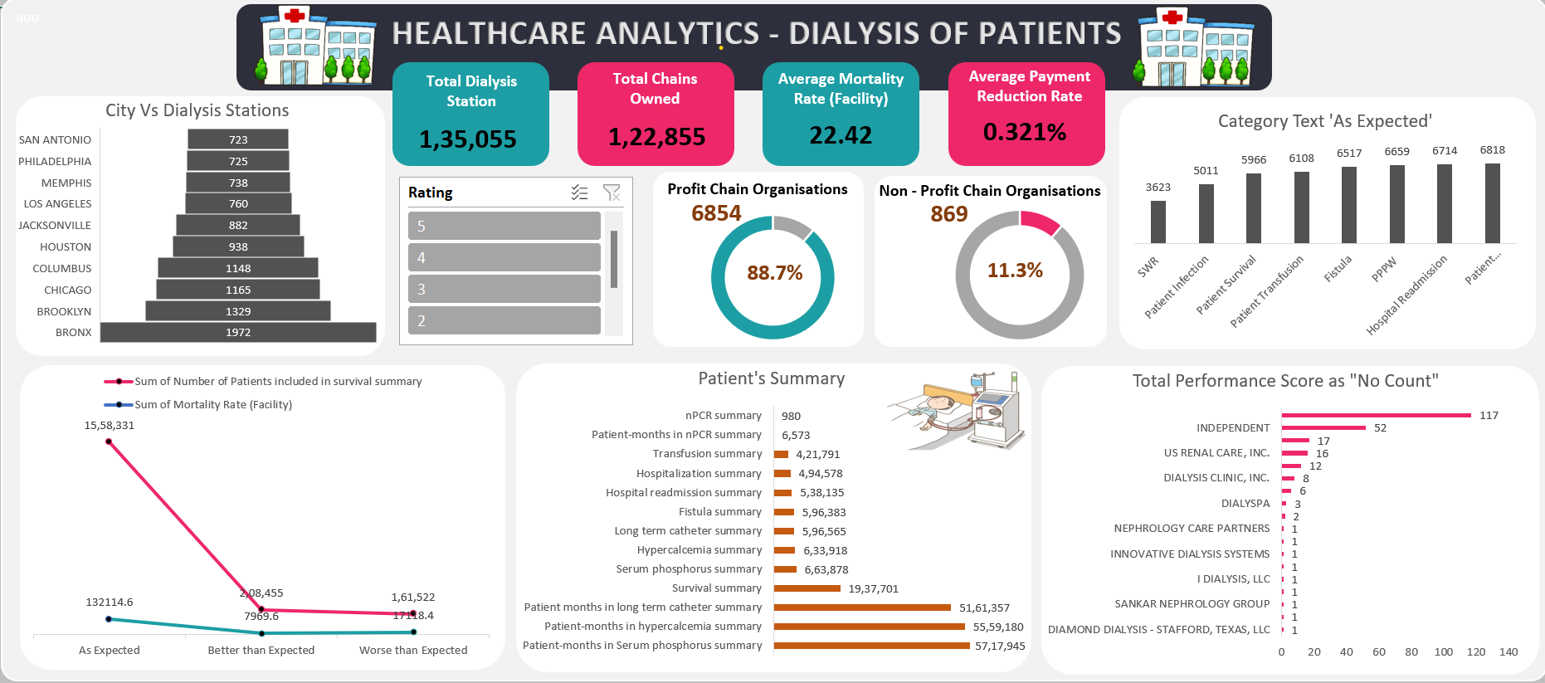
Excel Dashboard
Overview
By using an Excel dashboard, dialysis healthcare analytics can be visually presented in a user-friendly and interactive manner.

Slide 6
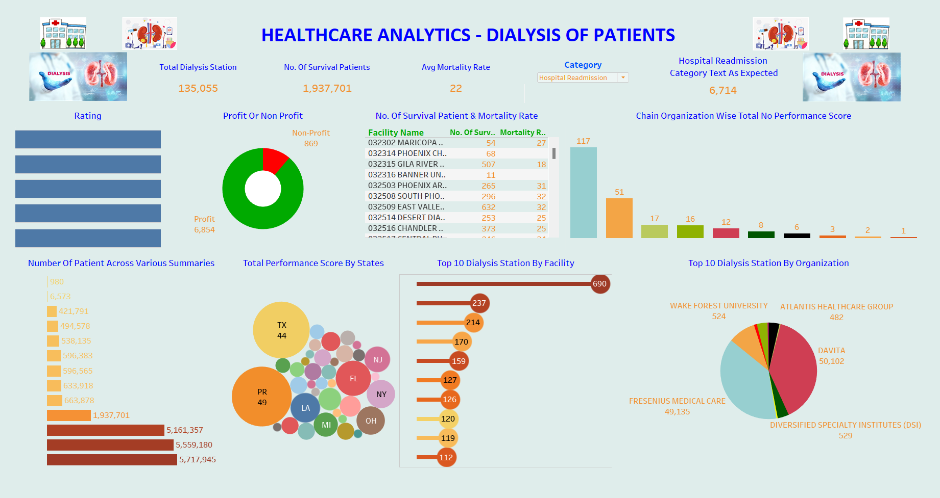
Tableau Dashboard
Overview
It provides a comprehensive and intuitive platform for healthcare providers to analyze and monitor key KPIs in the dialysis care sector for more accurate forecasting.

Slide 7
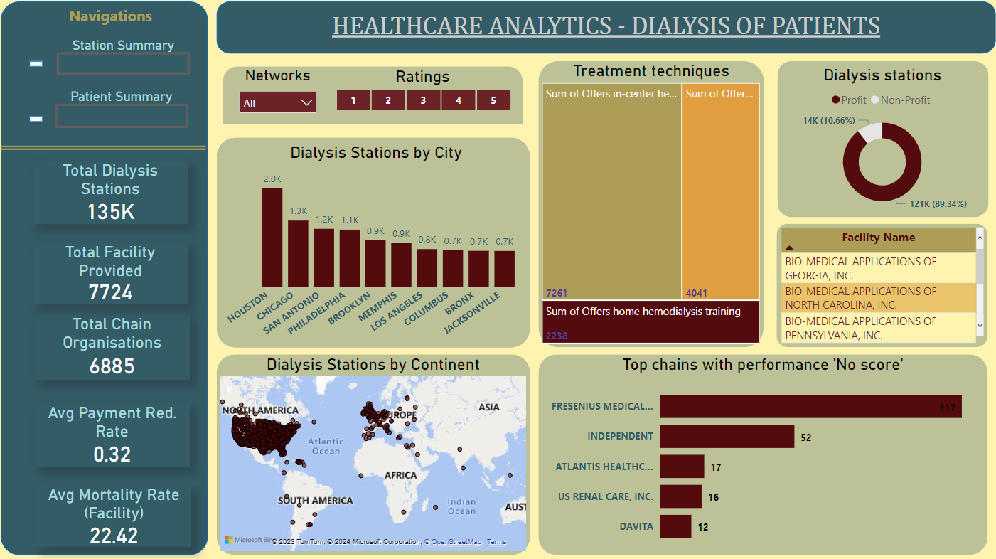
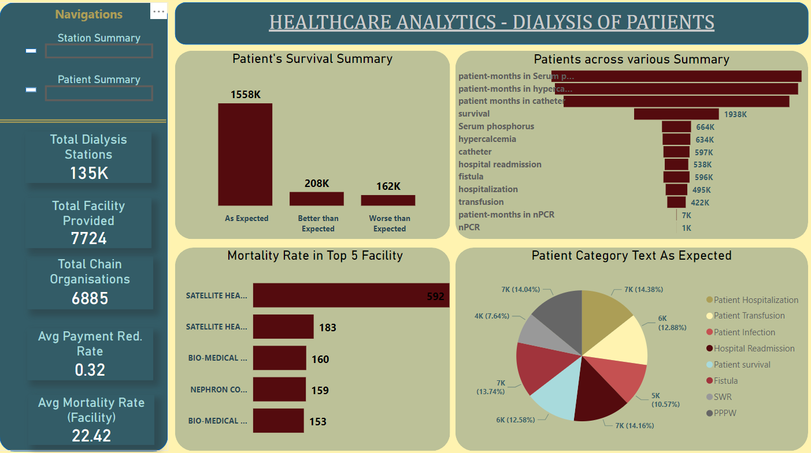
Power BI Dashboard
Overview
Power BI dashboard in analytics provides a comprehensive view of key metrics which we segregate in terms of station summary stats and patient summary stats.

Slide 8
Conclusion
Survival summary has the highest patient count , indicating positive outcomes.
Approximately 88.7% of facilities generate profit , while non-profit facilities need concentration.
Chain organization with Total performance score as ‘No Score’ need more attention. For e.g. Fresenius Medical care with 117 count as No score.
The number of dialysis stations increased until 2018 and then started declining, which is concerning.
The survival category has a good patient count, while hospitalization has the highest count.
By leveraging these analytics, healthcare providers can optimize care delivery, improve operational efficiency, enhance financial performance, and ultimately improve patient outcomes in the dialysis care sector.
Key points

Slide 9
Thank You.

